Slide 1
Topic Modelling on ESG statements and CO2 emissions value extraction from reports of top 100 publicly listed German Companies.
Mohammad Faiz Usmani (1323197)
Namratha Malavalli Balachandra (1293120)
Javed Khan (1292875)
Muhammad Ismail (1293531)
FRA-UAS (HIS)
Faculty 2 Computer Science and Engineering

Slide 2
Agenda
Introduction
Topic Modelling
Table Extraction and Cleaning
Relevant Value Extraction
Dashboard
Conclusion

Slide 3
Topic Modelling

Slide 4
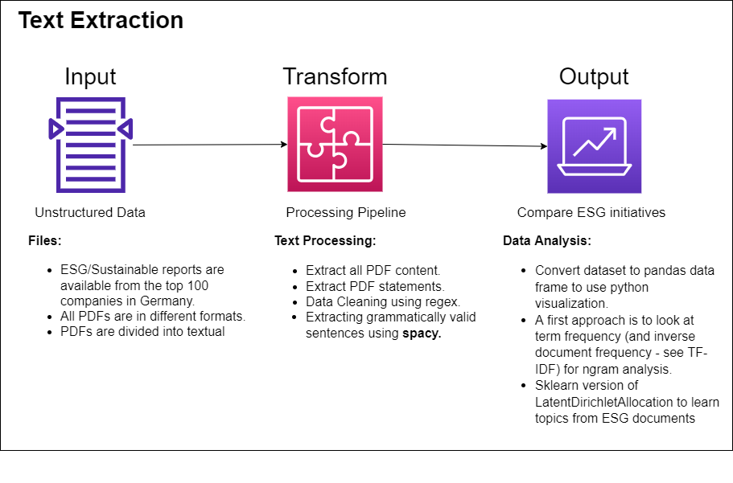
Aim for Text Extraction

Slide 5
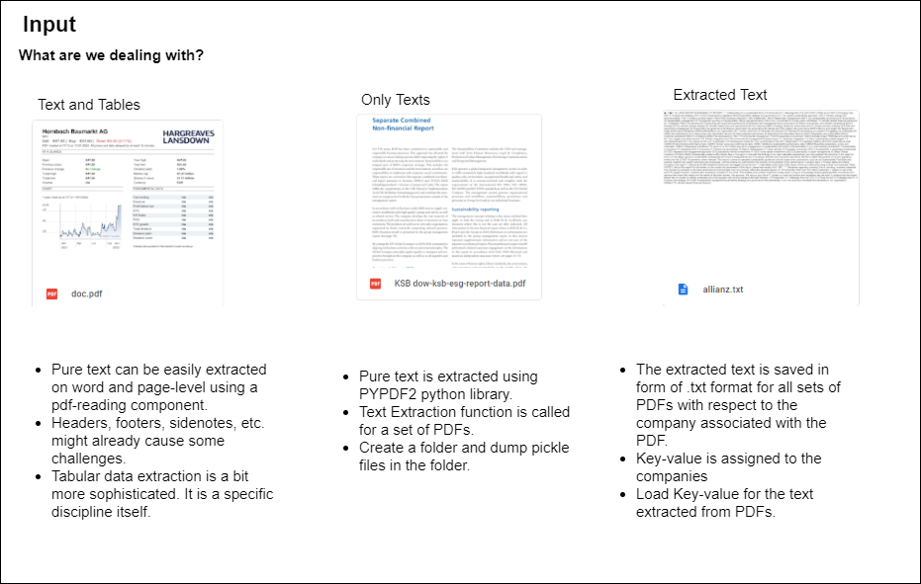
Text Extraction

Slide 6
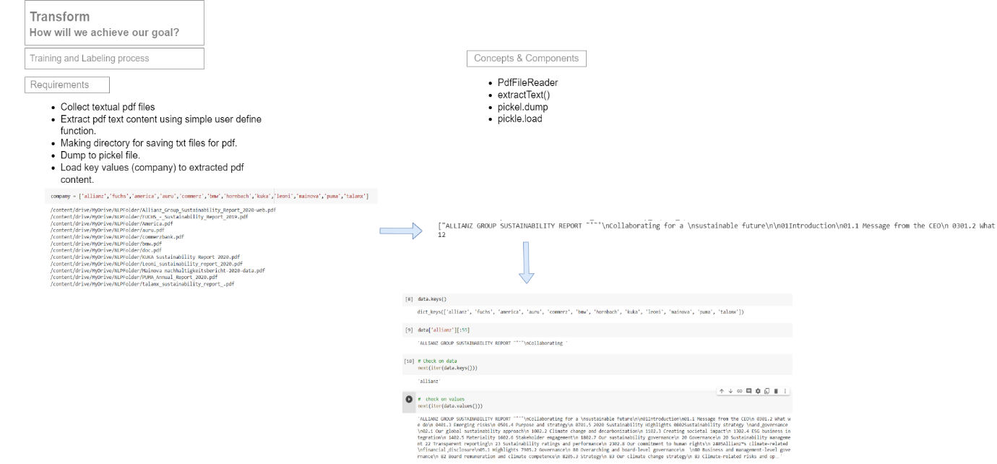
Transform – Training & Labeling

Slide 7
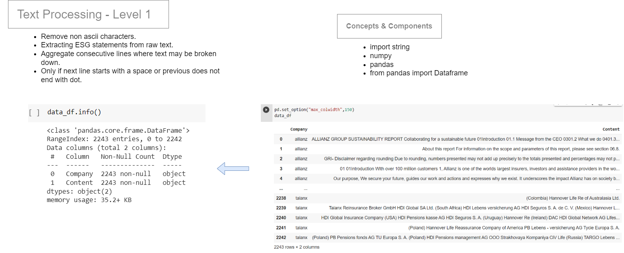
Text Processing – Level 1

Slide 8
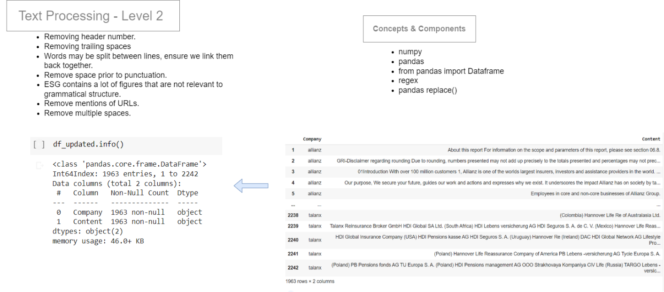
Text Processing – Level 2

Slide 9
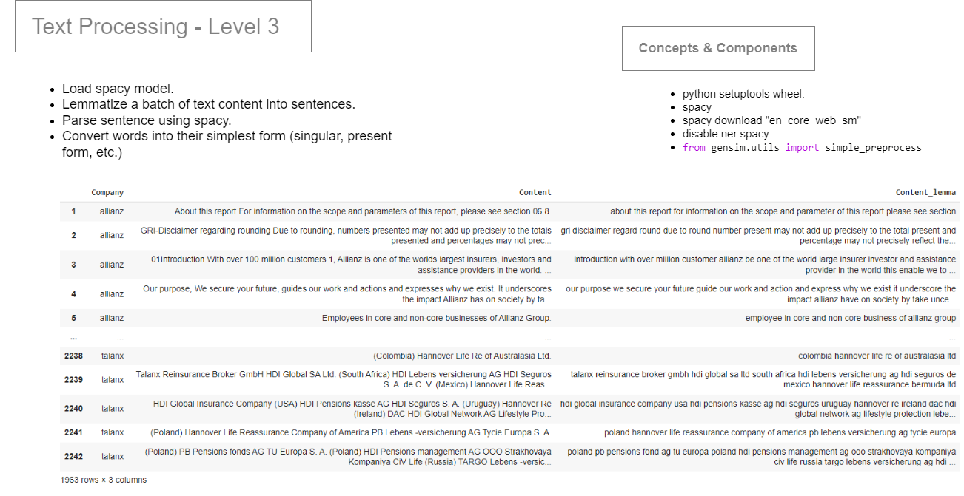
Text Processing – Level 3

Slide 10
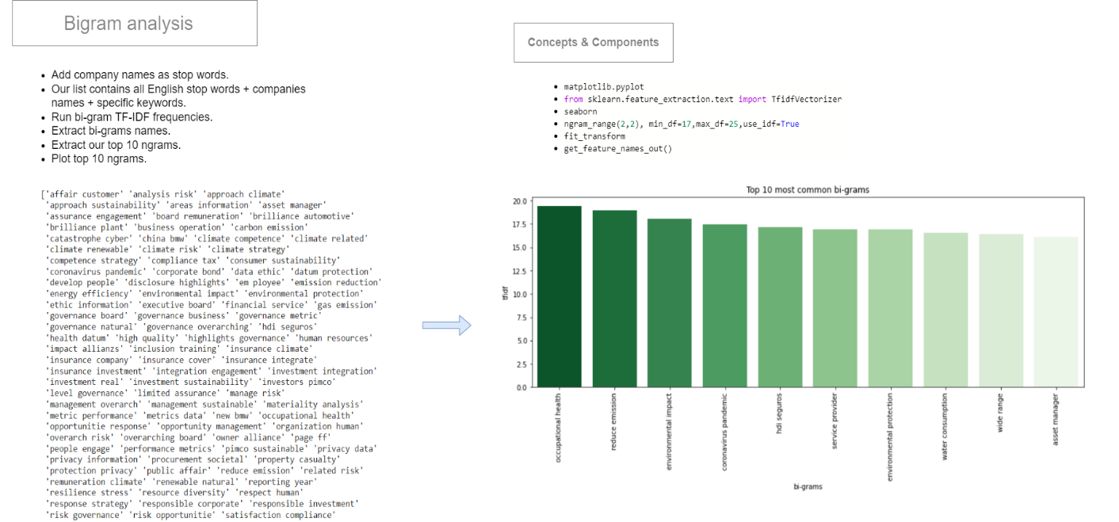
Bigram Analysis

Slide 11
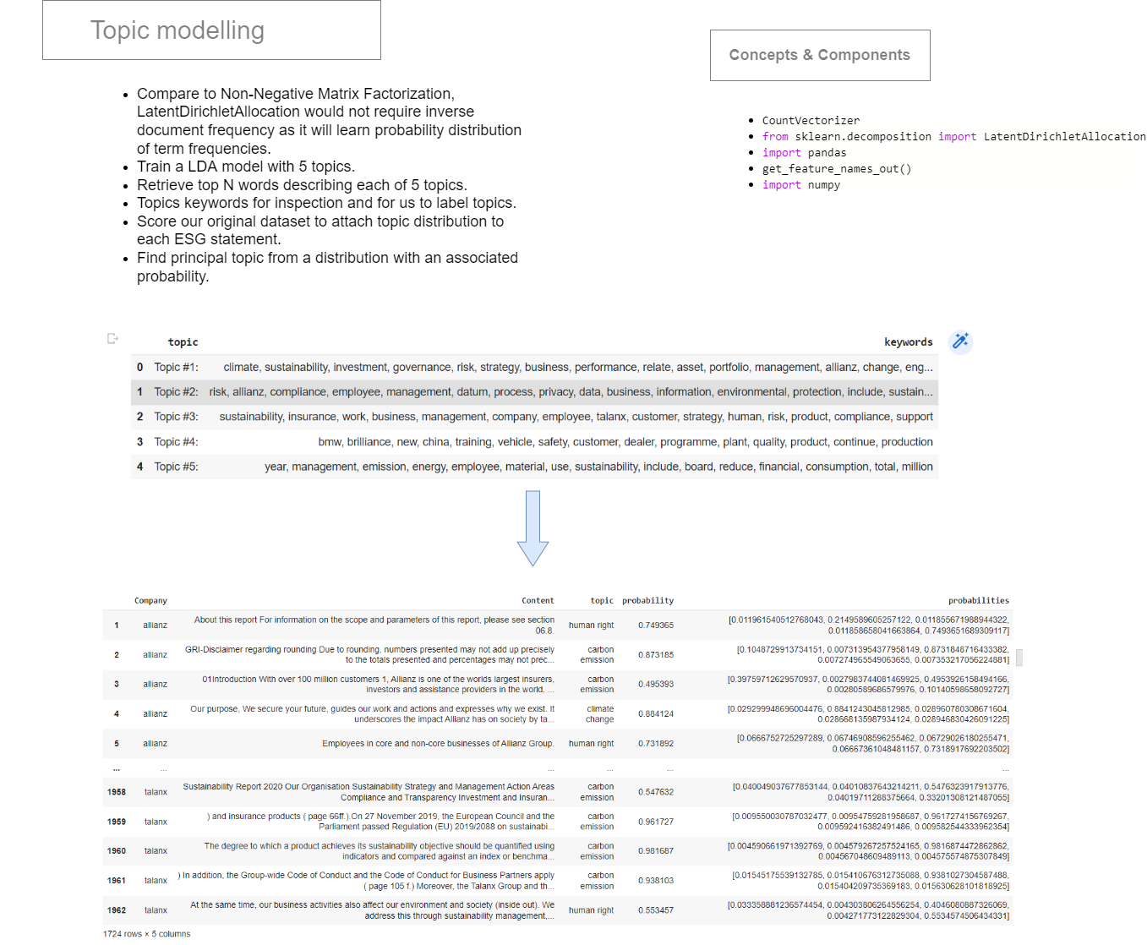

Slide 12
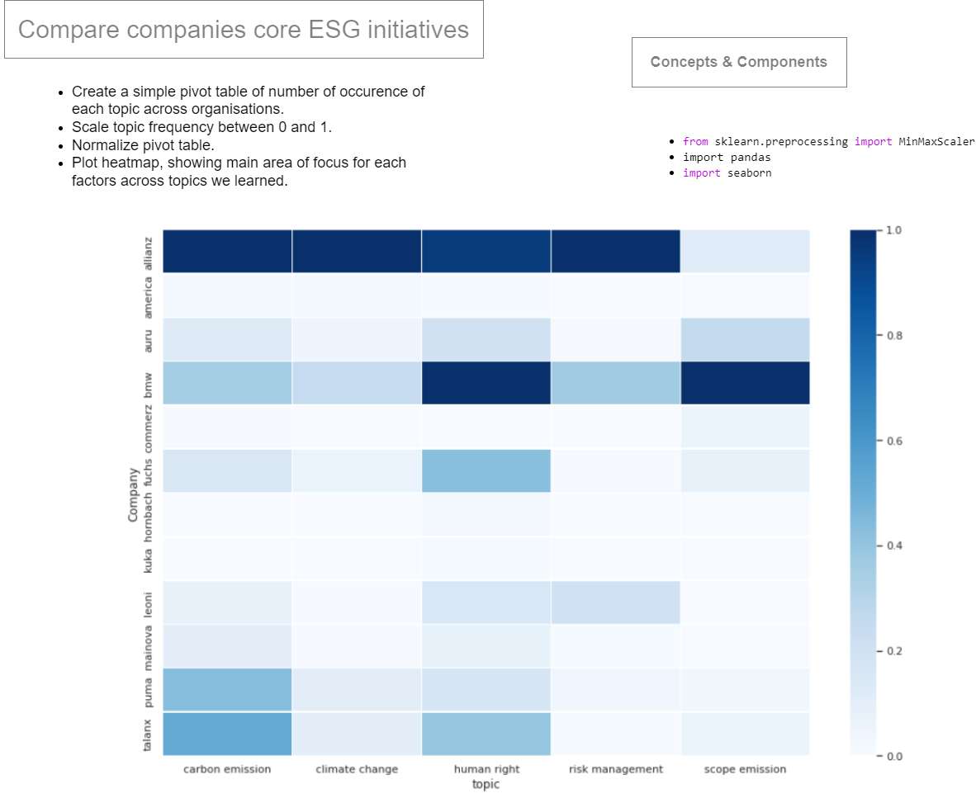
Output

Slide 13
Table Extraction and Cleaning

Slide 14
Related Works and Libraries
CascadeTabNet- Cascade mask Region-based CNN High-Resolution Network based model that detects the regions of tables and recognizes the structural body cells from the detected tables at the same time. ^{[1]}
Best Libraries in python such as Camelot and Tabula for table detection.
Transformers based on question and answering tasks working on tables trained on a certain annotated tabular dataset (Tapas trained on WTQ dataset). ^{[2]}

Slide 15
Challenges
The Reports of companies contains 100‘s of pages and are made in a visually enriching way with different formatting styles.
CascadeTabNet is able to detect simple tables from images (usually tables with black lines and text on white paper)
The functions and attributes provided by Camelot for specifying the area where a table is present and guessing the table structure are rendered useless for batch processing.
Processing the whole single pdf with lots of pages by Camelot takes a huge amount of time.
The tables with different designs, text color etc. are detected with nearby text as part of the table or not detected at all.

Slide 16
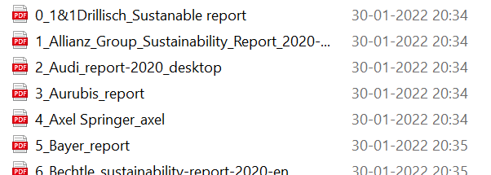
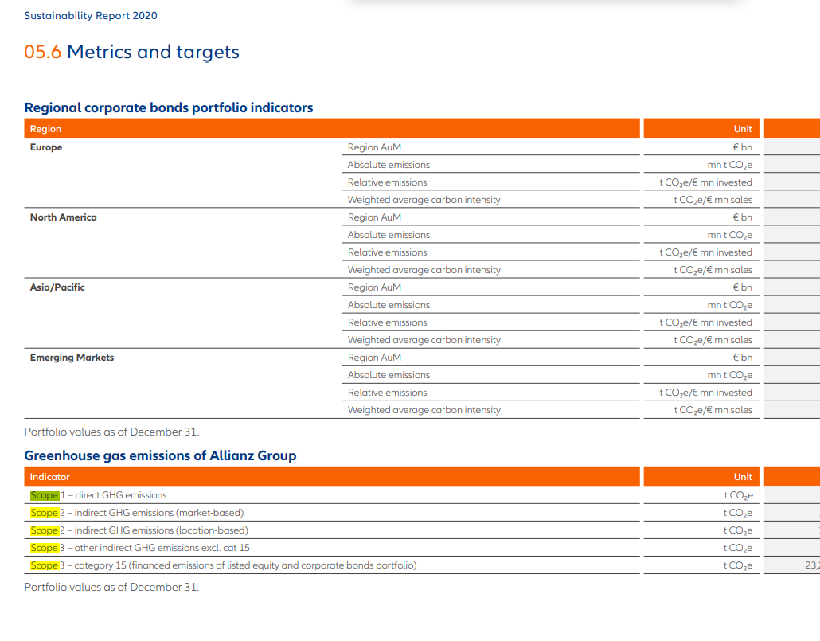
Approach
Os module to loop on files.
Pikepdf to convert all the pdf‘s into the same encryption method, because of Camelot‘s inability to process pdf’s made in different encryption methods.
Using Pypdf2 with regex for detecting the pages where the words ‘scope’ and ‘CO2’ are present, and feeding only those pages to Camelot, this step reduced the processing time by 90%.
Only further processing those pdf‘s extracted by Camelot which contains the words – scope, tonn, tco2 in any form using regex.

Slide 17
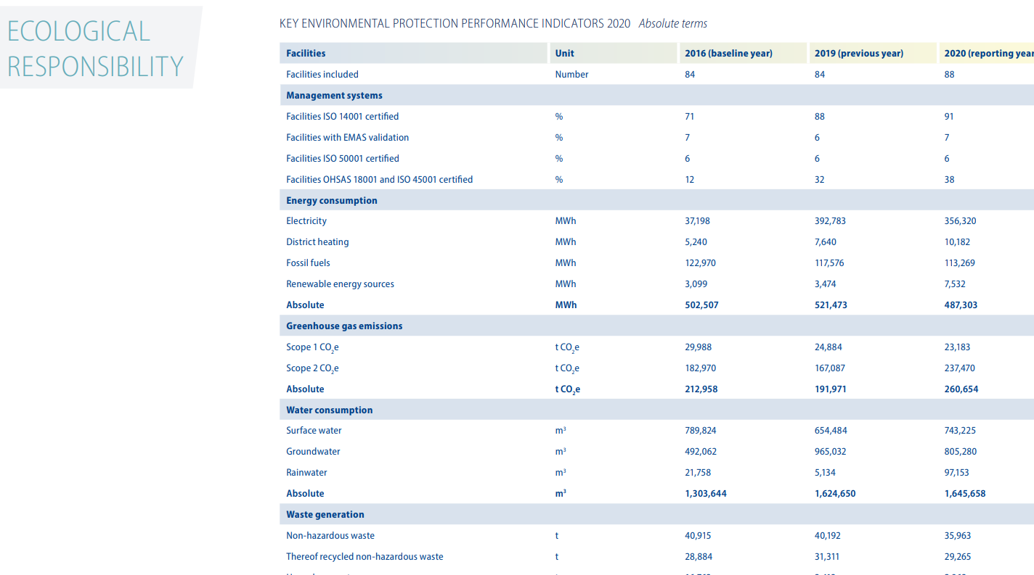
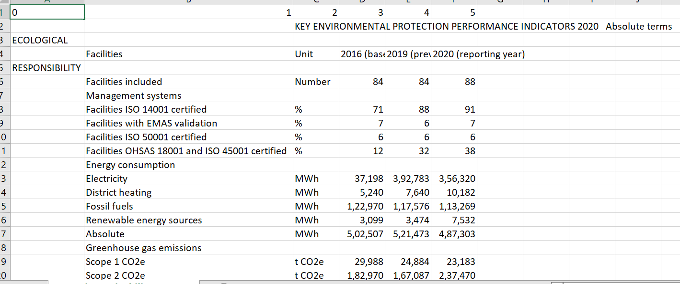
Approach (contd.)
The dynamic cleaning occurs for the uncleaned csv’s which performs some tasks :
Calculate the number of cells with nan(empty values) in a column and if they are greater than a certain threshold (50% of the cells in the column), delete the column. Do the same for all columns and then the rows.
See if there is a row containing 2020 or 2019 in one of the cell, if yes make it the header row and delete the rows above it. Otherwise, take the first row as the header row.

Slide 18
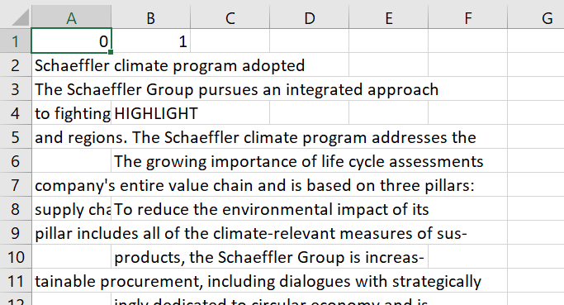
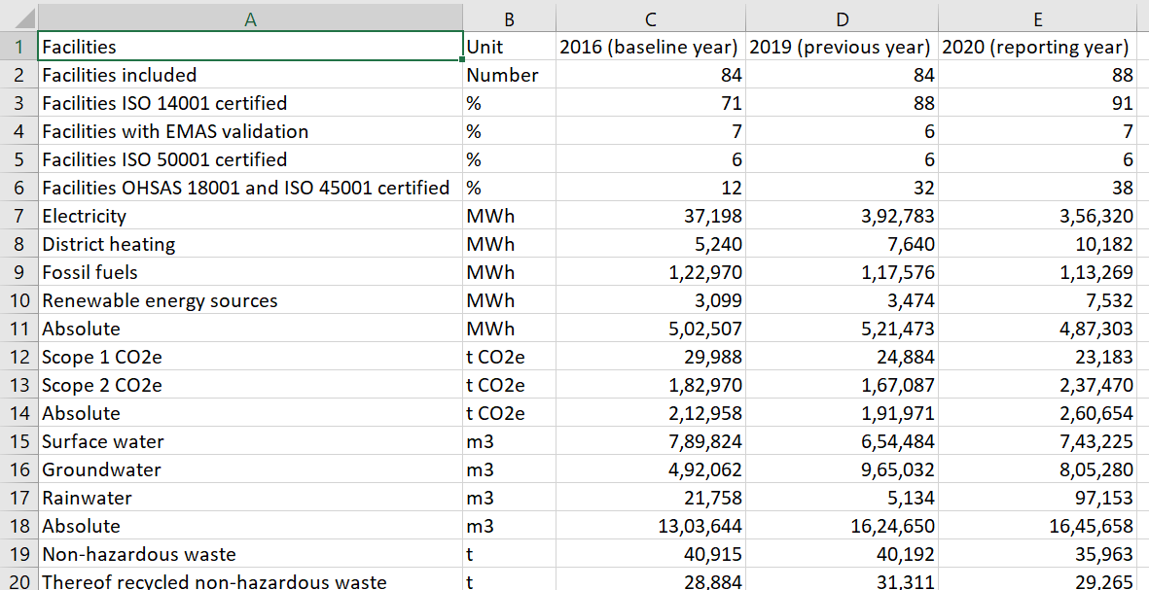
Approach (contd.)
Calculate the average length of each cell in the table and if they are greater than a certain threshold, don’t process it further.
Finally, save the cleaned table with columns greater than 2. Along with the Table to text conversion for all rows in the form – [Row] has value [Cell value] for [Column Header].
Ex- Scope 1 CO2e has value 23,183 for 2020 (reporting year).

Slide 19
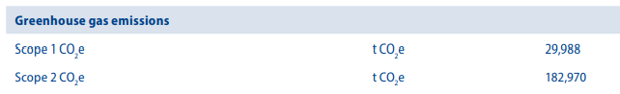
Alternative Approach for Relevant Data Extraction
Does not depend on any table extraction library because they fail to detect complex tables or small tables with a lot of texts around.
Example use case- Process the pdf using PDFMiner or pymupdf and get the pages containing a specific keyword i.e. ‘Scope 1’.
Get the positional attributes using library provided function of all words in that particular page(s).
Using regex on the position string extract its block number and extract all of the text in the same block. Apply another regex to extract only numerical values from returned answer.
Positional Range
x1, y1
x0, y0
x1, y1
x0, y0
Block

Slide 20
Relevant Value Extraction

Slide 21
3 Different Ways to Extract Information
HuggingFace Tapas Model
HuggingFace Roberta-base-squad2 Model
Manual Approach

Slide 22
HuggingFace
Hugging Face offers models based on Transformers for PyTorch and TensorFlow 2.0. There are thousands of pre-trained models to perform tasks such as text classification, extraction, question answering, and more. With its low compute costs, it is considered a low barrier entry for educators and practitioners.

Slide 23
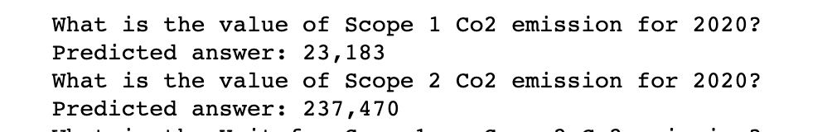
Tapas Model
It’s a BERT-based model specifically designed (and pre-trained) for answering questions about tabular data.
TAPAS is pre-trained on the masked language modeling (MLM)
The WikiTableQuestions(WTQ) dataset is for the task of question answering on semi-structured HTML tables as presented in the paper

Slide 24
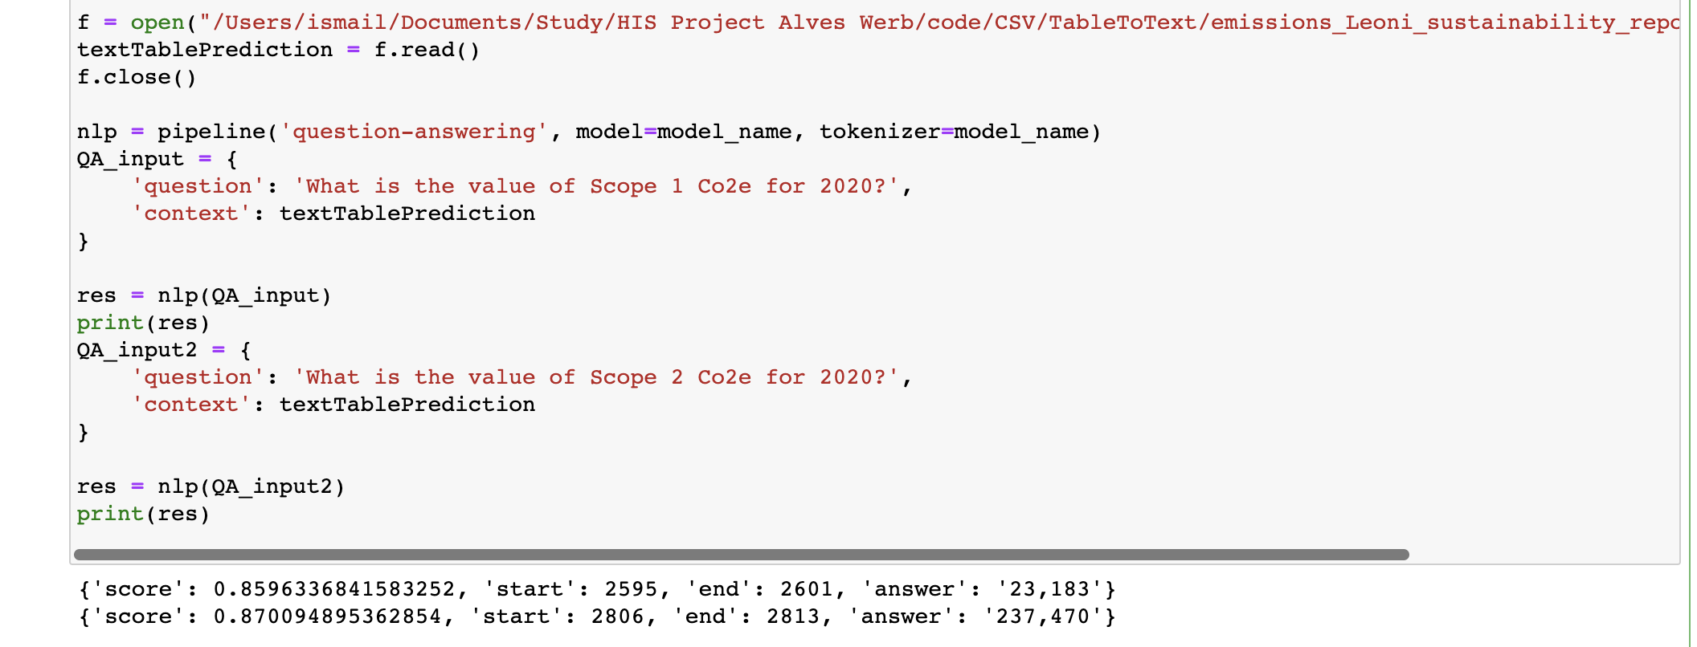
Roberta Base Squad2 Model

Slide 25
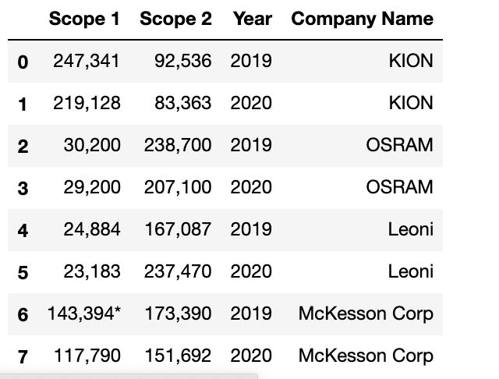
Manual Approach
Read all CSV’s
For 2019 & 2020 separate the columns and rows that contains Scope 1 and Scope 2 & store in different datasets
Combine all datasets
Some cleaning and export dataset to CSV

Slide 26
Results
Out of the 71 pdf’s processed (64 containing values in tables), in 36 pdf’s correct tables were detected, cleaned and value was extracted successfully with minor tweaking. ( just breaking the barrier of 50%).
The approach required lot of tweaking and it may be possible that unknowingly it is catering to the pdf’s we processed.
But with certainty, it can be said that if the table is present in full page or half the page. It would be successfully cleaned of the extra texts and the right value would be extracted in less amount of time then the regular extraction of table using Camelot/Tabula and then manual cleaning.

Slide 27
Dashboard

Slide 28
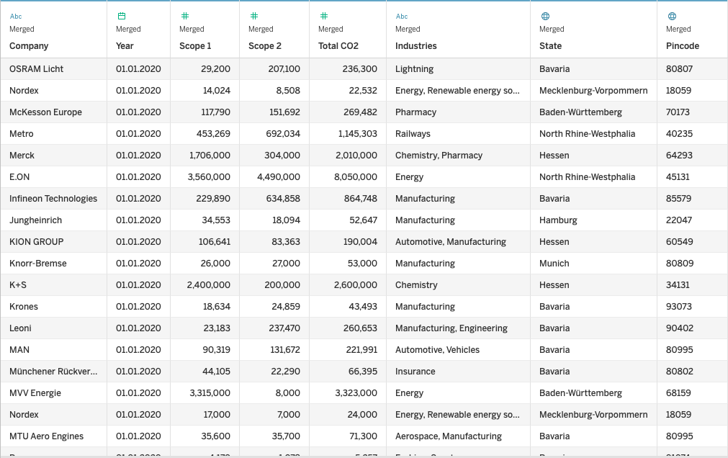
Data Schema

Slide 29
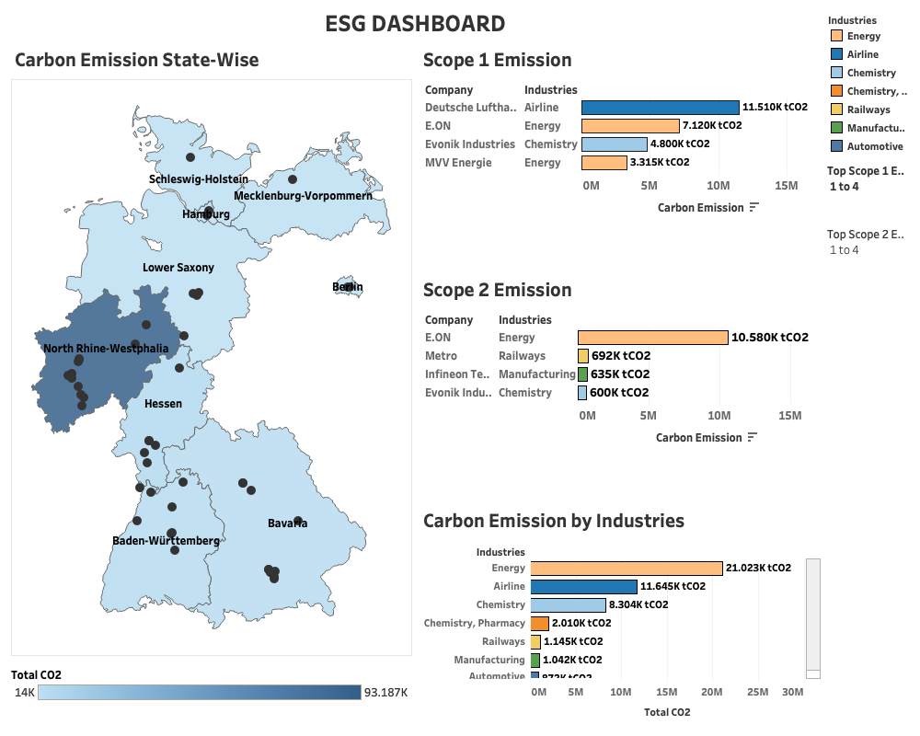
Group 1 | Project Presentation – Project HIS

Slide 30
Conclusion

Slide 31
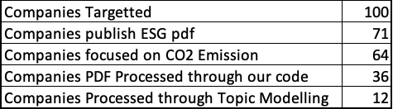
Conclusion

Slide 32
References
[1] D. Prasad, A. Gadpal, K. Kapadni, M. Visave and K. Sultanpure, "CascadeTabNet: An approach for end to end table detection and structure recognition from image-based documents," 2020 IEEE/CVF Conference on Computer Vision and Pattern Recognition Workshops (CVPRW), 2020, pp. 2439-2447, doi: 10.1109/CVPRW50498.2020.00294.
[2] https://huggingface.co/docs/transformers/model_doc/tapas
[3] https://huggingface.co/docs/transformers/main_classes/pipelines
[4] https://huggingface.co/docs/transformers/main_classes/tokenizer [5] https://huggingface.co/tasks/question-answering
[6] https://proceedings.neurips.cc/paper/2007/file/d56b9fc4b0f1be8871f5e1c40c0067e7-Paper.pdf
[7] https://pandas.pydata.org/docs/reference/index.html
[8] https://pythonhosted.org/PyPDF2/
[9] https://spacy.io/models/en
[10] https://scikit-learn.org/stable/
[11] https://radimrehurek.com/gensim/models/ldamodel.html

Slide 33
Thank You.

